Slide 1
AIRLINE BOOKING SYSTEM
USING DATA STRUCTURE AND ALGORITHM
BY:
JAYADEEP – RA2211042010005
YESHWIN – RA2211042010009
YESHWANTH RAGHAVENDAR – RA2211042010017

Slide 2

TECHNOLOGY BEHIND THIS PROJECT
LOGIC USED -> LINKED LIST IN DATA STRUCTURES AND ALGORITHM
PROGRAM USED -> C LANGUAGE

Slide 3

DATA STRUCTURE AND ALGORITHM
Data Structure
A data structure is defined as a particular way of storing and organizing data in our devices to use the data efficiently and effectively. The main idea behind using data structures is to minimize the time and space complexities. An efficient data structure takes minimum memory space and requires minimum time to execute the data.
Algorithm
Algorithm is defined as a process or set of well-defined instructions that are typically used to solve a particular group of problems or perform a specific type of calculation. To explain in simpler terms, it is a set of operations performed in a step-by-step manner to execute a task.

Slide 4
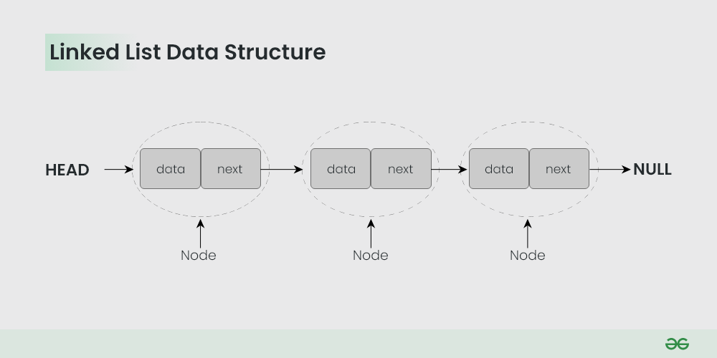
LINKED LIST
A linked list is a linear data structure, in which the elements are not stored at contiguous memory locations.
The elements in a linked list are linked using pointers.
Each element, often called a node, contains two fields: a data field and a link field that contains the address of the next node.
The last node of the list contains a pointer to null, signifying the end of the list. Linked lists can be used in many applications, including implementation of stacks, queues, and graphs

Slide 5
Advantages:
Dynamic data structure: Linked list is a dynamic data structure so it can grow and shrink at runtime by allocating and deallocating memory
No memory wastage: In the linked list, efficient memory utilization can be achieved since the size of the linked list increase or decrease at run time so there is no memory wastage
Efficient Insertions/Deletions: Insertions and deletions at any place in a list can usually be done more efficiently than in an array
Implementation of stacks and queues: Linked lists are also used to implement other data structures like stacks and queues
Disadvantages:
Slow Access Time: Accessing elements in a linked list can be slow, as you need to traverse the linked list to find the element you are looking for, which is an O(n) operation
No Random Access: Random access is not allowed. We have to access elements sequentially starting from the first node
Extra memory space for a pointer: Each element of a linked list requires storing an extra pointer to the next element, which increases the memory requirements

Slide 6
MOTIVE BEHIND THIS PROJECT
When it comes to the features of airline booking, the system requires information such as the passenger's name, passport number, and email address. A reservation is made once all of these steps have been completed. The system delivers a seat number as evidence of reservation. To check tickets, the user must first submit a seat number, after which the system will search the database for the appropriate tickets and provide the results. The technology makes canceling a flight reservation simple; the user only has to enter their seat number.

Slide 7
ALGORITHM
Define the structure:
Define a structure mufti_airline with fields for passport, name, destination, seat number, email, and a pointer to the next node.
Initialize:
Initialize two pointers begin and stream to NULL. These will be used to keep track of the start of the list and the current node respectively.
Start the main loop:
Start a loop that continues until the user chooses to exit. In each iteration, display a menu and ask the user to choose an option.

Slide 8
Switch case for user’s choice:
If the user chooses to reserve a seat:
If it’s the first reservation, allocate memory for a new node, get the details from the user, set following to NULL, and print a success message.
If it’s not the first reservation but there are less than 15 reservations, allocate memory for a new node at the end of the list, get details from the user, set following to NULL, and print a success message.
If there are already 15 reservations, print a message that all seats are full.
If the user chooses to cancel a reservation:
Ask for the passport number of the reservation to be cancelled.
If it’s the first reservation in the list, remove it and adjust begin to point to the next node.
If it’s not the first reservation, find it in the list and remove it by adjusting following of the previous node to point to the next node.
If the user chooses to display records:
Start from begin and print details of each reservation until you reach the end of the list.
If the user chooses to exit:
Open a file named “mufti records”.
Write details of each reservation into this file.
Close this file.

Slide 9
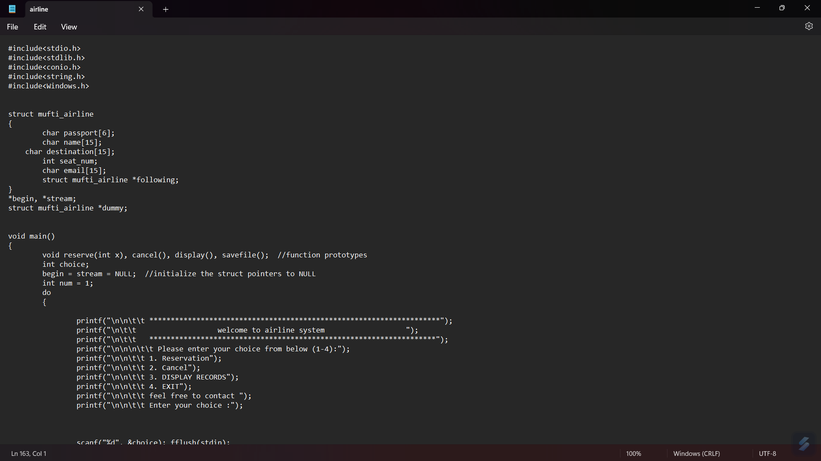
SOURCE CODE

Slide 10
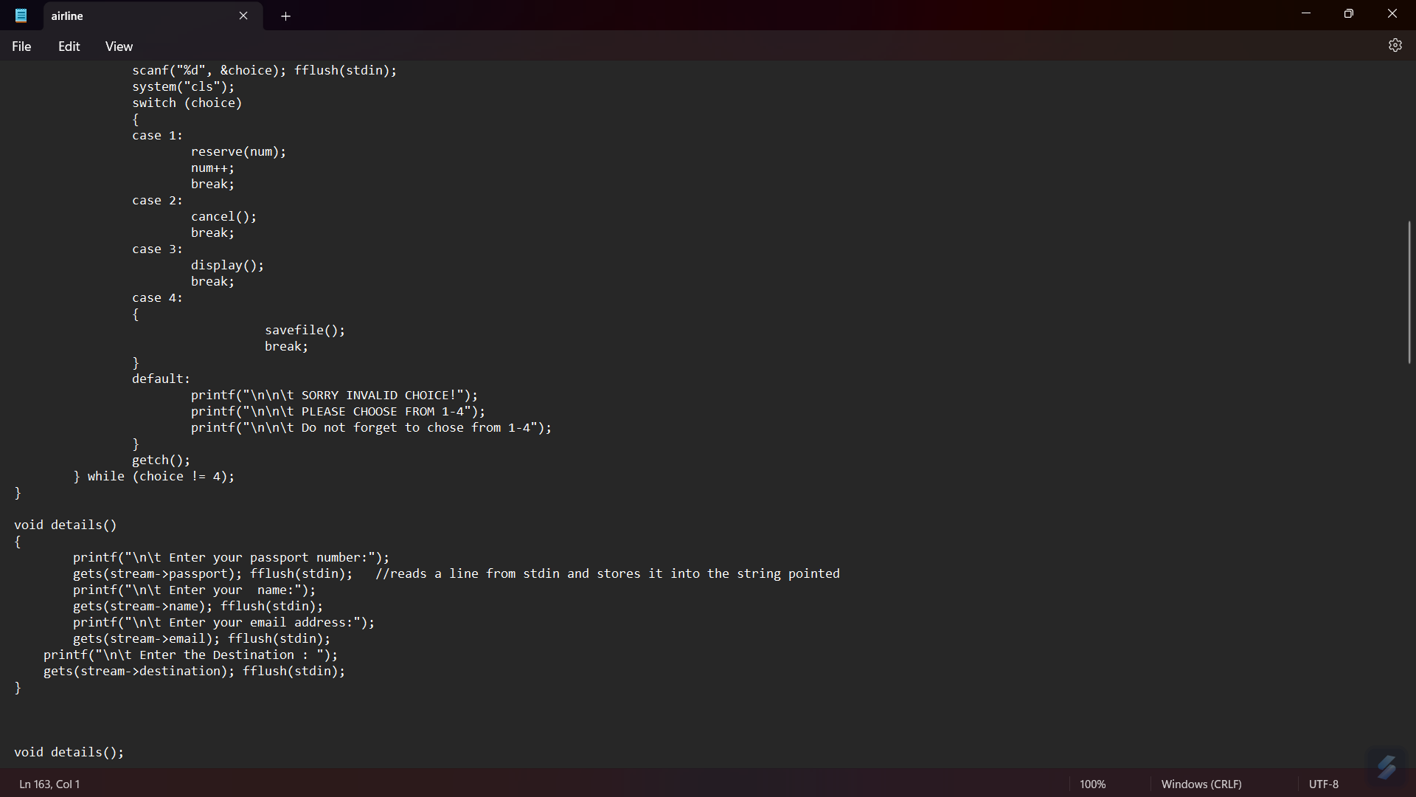

Slide 11
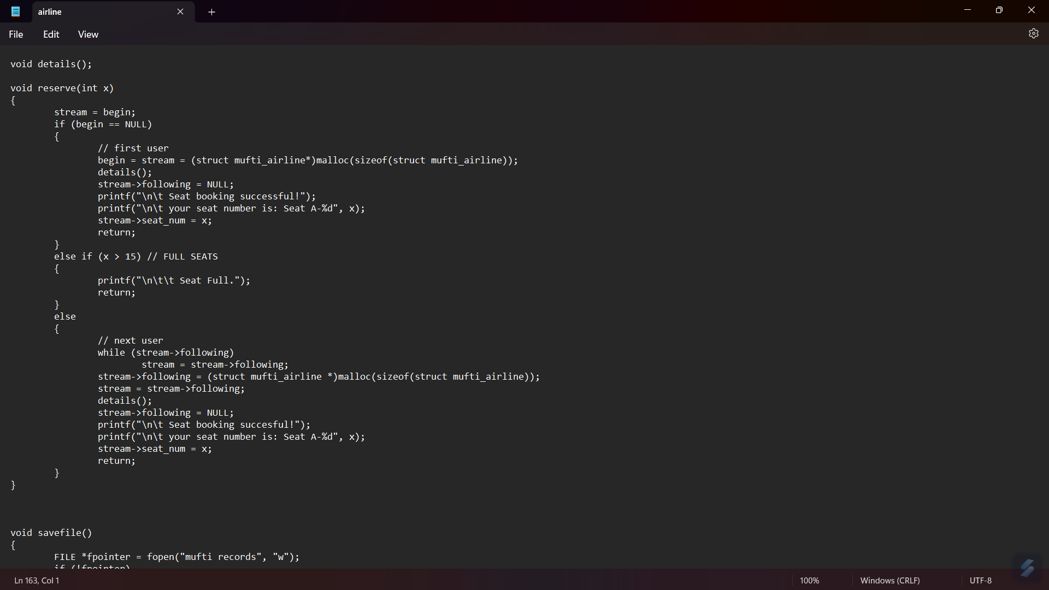

Slide 12
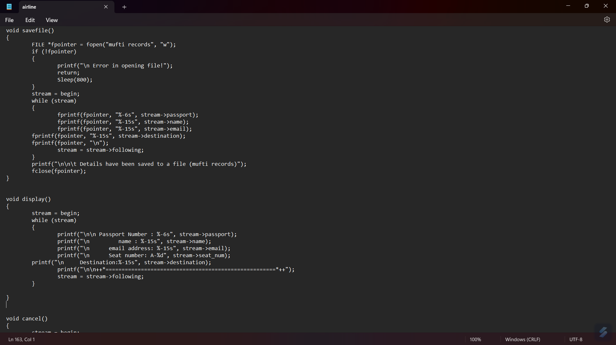

Slide 13
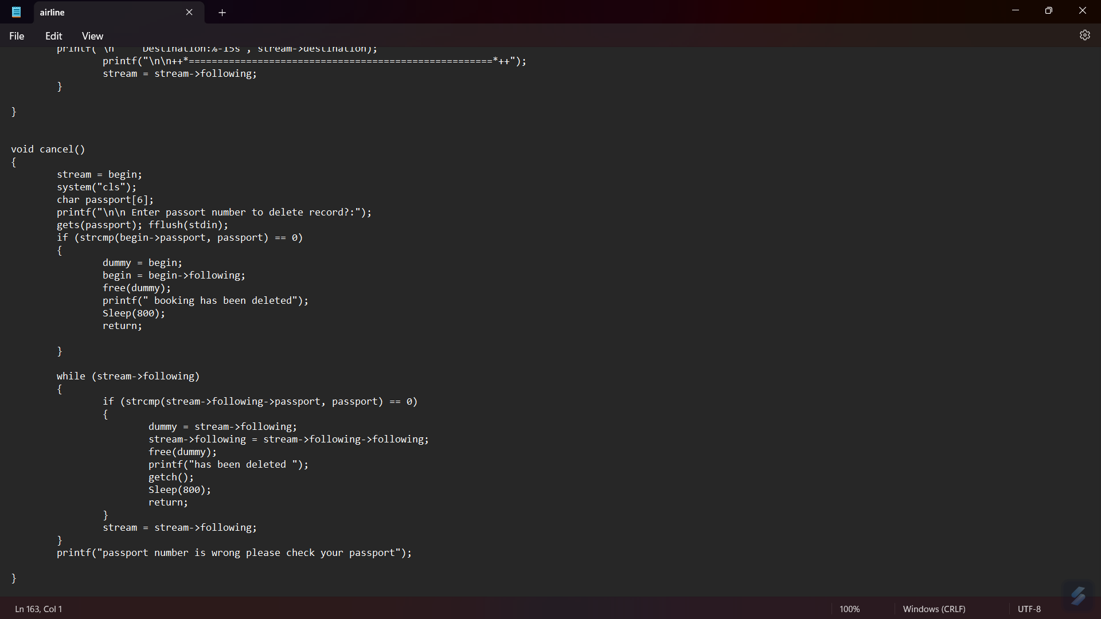

Slide 14
CODE BREAKDOWN
MAIN:
This is the main function where the program starts. It initializes the linked list and enters a loop where it displays a menu to the user and asks for their choice. Depending on the user’s choice, it calls the appropriate function.
RESERVE:
This function is used to reserve a seat. It takes an integer x as an argument which represents the seat number. If it’s the first reservation, it creates a new node at the beginning of the list. If it’s not the first reservation but there are less than 15 reservations, it creates a new node at the end of the list. If there are already 15 reservations, it prints a message that all seats are full.
CANCEL:
This function is used to cancel a reservation. It asks for the passport number of the reservation to be cancelled. If it’s the first reservation in the list, it removes it and adjusts begin to point to the next node. If it’s not the first reservation, it finds it in the list and removes it by adjusting following of the previous node to point to the next node.

Slide 15
DISPLAY:
This function is used to display all reservations. It starts from begin and prints details of each reservation until it reaches the end of the list.
SAVE FILE:
This function is used to save all reservations to a file named “mufti records”. It opens this file, writes details of each reservation into this file, and then closes this file.
DETAILS:
This function is used to get details from the user for a reservation. It asks for passport number, name, email address, and destination, and stores these details in the current node pointed by stream.
Each function plays a specific role in managing an airline reservation system using a singly linked list data structure.

Slide 16
MAIN FUNCTION
The main function is the entry point of the program and controls the flow of the airline reservation system.
The function first declares and initializes several variables and pointers:
begin and stream are pointers to the start of the linked list and the current node respectively, and are initialized to NULL.
choice is an integer variable to store the user’s choice from the menu.
num is an integer variable to store the seat number, and is initialized to 1.
The function then enters a loop that continues until the user chooses to exit (i.e., until choice becomes 4). In each iteration of this loop, it does the following:
Prints a menu to the console and asks the user to enter their choice.
Clears the console screen using system("cls").
Uses a switch statement to call the appropriate function based on the user’s choice:
If choice is 1, it calls the reserve function with num as an argument and increments num.
If choice is 2, it calls the cancel function.
If choice is 3, it calls the display function.
If choice is 4, it calls the savefile function.
If choice is not between 1 and 4, it prints an error message.
Waits for user input using getch() before continuing to the next iteration.
So essentially, this function displays a menu to the user, gets their choice, and performs the corresponding operation. It continues to do this until the user chooses to exit. At that point, it saves all reservations to a file before ending the program.

Slide 17
RESERVE FUNCTION
The reserve function in the provided code is used to reserve a seat in the airline system.
1.The function takes an integer x as an argument, which represents the seat number.
It checks if begin (the start of the linked list) is NULL, which means this is the first reservation.
If it is the first reservation, it allocates memory for a new node, gets the details from the user by calling the details function, sets following to NULL (indicating the end of the list), and prints a success message. It also sets stream->seat_num to x, which is the seat number.
If it’s not the first reservation, it checks if x is greater than 15, which means all seats are full.
If all seats are full, it prints a message saying “Seat Full” and returns from the function.
If it’s not the first reservation and there are less than 15 reservations, it enters a loop to find the end of the list.
In this loop, while stream->following is not NULL, it moves stream to the next node by setting stream = stream->following.
Once it finds the end of the list, it allocates memory for a new node at the end of the list, gets details from the user by calling the details function, sets following to NULL (indicating the end of the list), and prints a success message. It also sets stream->seat_num to x, which is the seat number.
So essentially, this function adds a new reservation at either the beginning or end of the linked list depending on whether it’s the first reservation or not. It also checks if all seats are full before making a new reservation.

Slide 18
CANCEL FUNCTION
The cancel function is used to cancel a reservation in the airline system.
The function first sets stream to begin, which is the start of the linked list.
It then clears the screen using system("cls").
It asks for the passport number of the reservation to be cancelled and stores it in a local variable passport.
It checks if the passport number of the first reservation in the list (i.e., begin->passport) matches the entered passport number.
If it matches, it sets dummy to begin, moves begin to the next node (i.e., begin->following), frees the memory allocated to dummy (thereby deleting the first reservation), prints a message saying “booking has been deleted”, waits for 800 milliseconds using Sleep(800), and returns from the function.
If it’s not the first reservation, it enters a loop to find the matching reservation in the list.
In this loop, while stream->following is not NULL, it checks if the passport number of the next reservation (i.e., stream->following->passport) matches the entered passport number.
If it matches, it sets dummy to stream->following, moves stream->following to the next node (i.e., stream->following->following), frees the memory allocated to dummy (thereby deleting the matching reservation), prints a message saying “has been deleted”, waits for user input using getch(), waits for 800 milliseconds using Sleep(800), and returns from the function.
If it doesn’t match, it moves stream to the next node by setting stream = stream->following.
If no matching reservation is found in the list, it prints a message saying “passport number is wrong please check your passport”.
So essentially, this function deletes a reservation from either the beginning or middle of the linked list depending on whether it’s the first reservation or not. It also handles cases where no matching reservation is found.

Slide 19
DISPLAY FUNCTION
The display function is used to display all reservations in the airline system.
The function first sets stream to begin, which is the start of the linked list.
It then enters a loop to traverse the list.
In this loop, while stream is not NULL, it prints details of each reservation including passport number, name, email address, seat number, and destination. It also prints a separator line for readability.
After printing the details of a reservation, it moves stream to the next node by setting stream = stream->following.
The loop continues until it has printed the details of all reservations in the list (i.e., until stream becomes NULL).
So essentially, this function traverses the entire linked list and prints the details of each reservation.

Slide 20
SAVEFILE FUNCTION
The savefile is used to save all reservations to a file.
The function first opens a file named “mufti records” for writing. If the file cannot be opened, it prints an error message, waits for 800 milliseconds using Sleep(800), and returns from the function.
It then sets stream to begin, which is the start of the linked list.
It enters a loop to traverse the list.
In this loop, while stream is not NULL, it writes details of each reservation including passport number, name, email address, and destination to the file. Each detail is written in a separate field with a width of 6 or 15 characters as appropriate, and each reservation is written in a new line.
After writing the details of a reservation, it moves stream to the next node by setting stream = stream->following.
The loop continues until it has written the details of all reservations in the list (i.e., until stream becomes NULL).
After all reservations have been written to the file, it prints a message saying “Details have been saved to a file (mufti records)” and closes the file.
So essentially, this function traverses the entire linked list and writes the details of each reservation to a file.

Slide 21
DETAILS FUNCTION
The details function is used to get details from the user for a reservation.
The function first prints a prompt asking the user to enter their passport number.
It then reads the user’s input using gets(stream->passport) and stores it in the passport field of the current node pointed by stream. The fflush(stdin) function is used to clear the input buffer.
The function repeats these two steps for the name, email address, and destination, storing the user’s input in the corresponding fields of the current node.
So essentially, this function gets details from the user and stores them in the current node of the linked list. The details include passport number, name, email address, and destination.

Slide 22
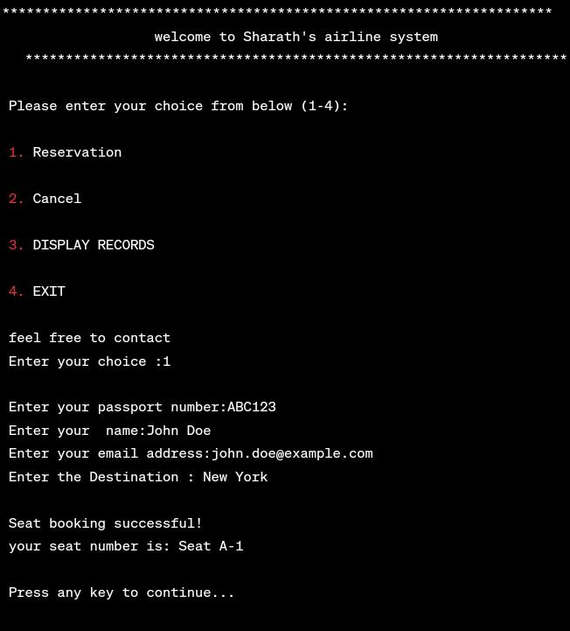
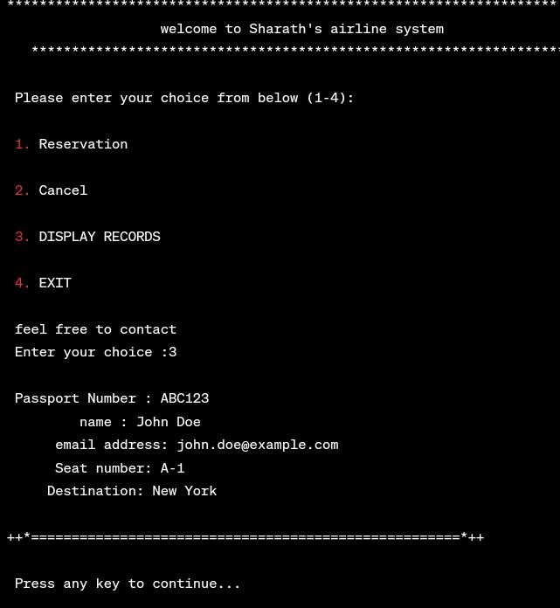
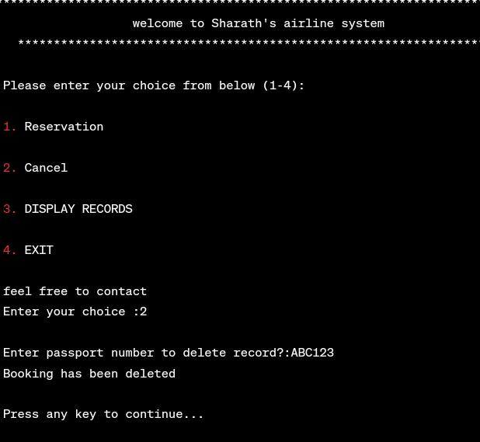
OUTPUT

Slide 23
CONCLUSION
This project uses the concept of data structures for solving the physical complications for booking a flight ticket by enabling the user to book the tickets at the ease of their phone.
It aims to save time and cost for the user.
Though it has few disadvantages like server clash or server issues, its advantages outruns its disadvantages. Thus enabling a wide group of people to book tickets at their ease.

Slide 24
THANK YOU

